Slide 1
Home Sales and Refurbishment
Marketing 653: Marketing Analytics
Fall 2018 Term
Group 5- Shane Stern, Bobby Schaible, Scott Snow

Slide 2
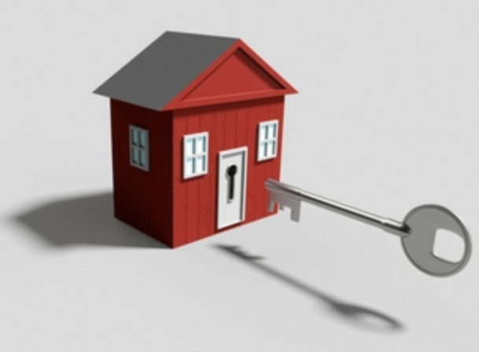
Executive Summary
Small company home investment group
Reviewing real-estate opportunities in Home sales in a typical college town
Looking into market areas that provide investment opportunities to refurbish homes for resale

Slide 3
Data Modeling

Slide 4
81 Unique variables
Data Modeling parameters

Slide 5
81 Unique variables
1460 Data points of consideration
Data Modeling parameters

Slide 6
81 Unique variables
1460 Data points of consideration
696 homes identified as remodeled
Data Modeling parameters

Slide 7
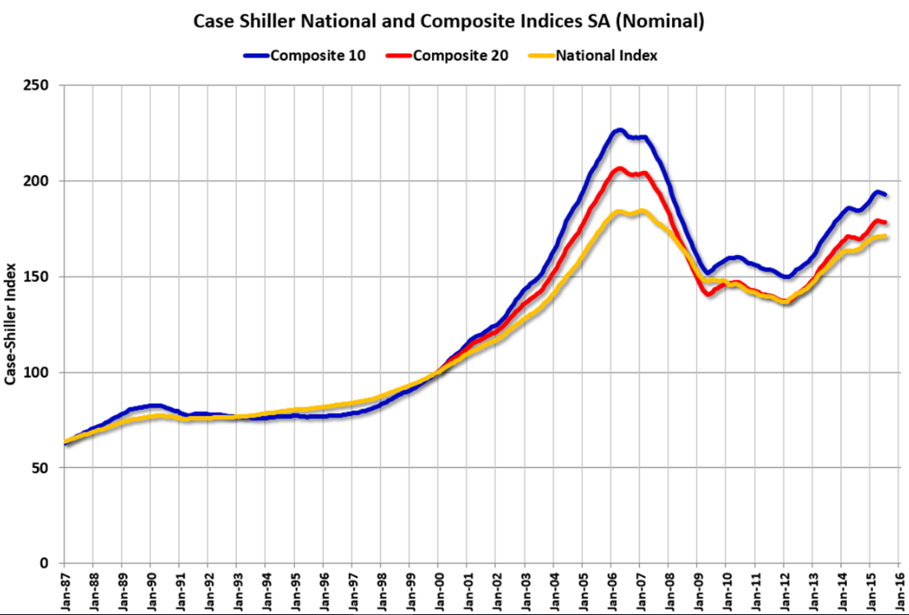
Pricing Index and Normalization
Case-Shiller U.S. National Home Price Index
What is it?
Composite home indices for all nine U.S. Census divisons
Calculated monthly
Normalized to have value of 100 in January 2000
Why we used it?
To normalize sales prices over period of time (2006-2010)
Eliminate economic and market conditions that affect pricing

Slide 8

Model Tuning

Slide 9
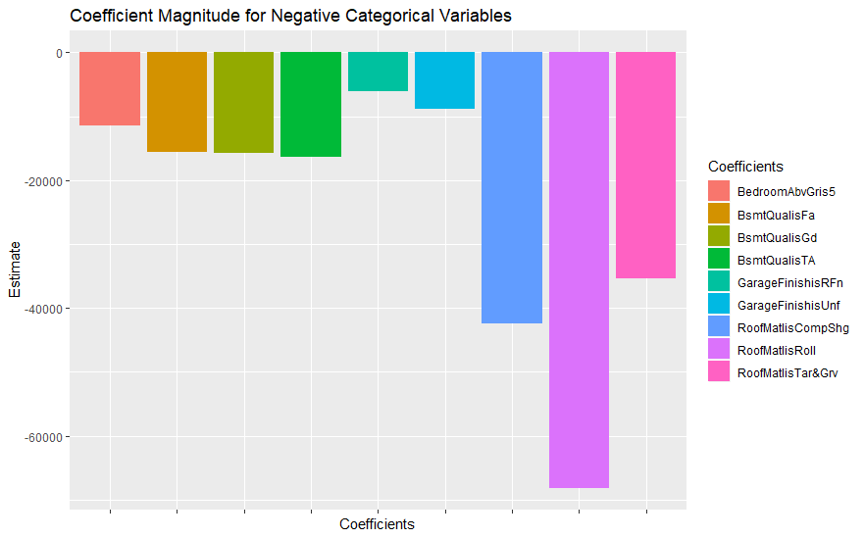
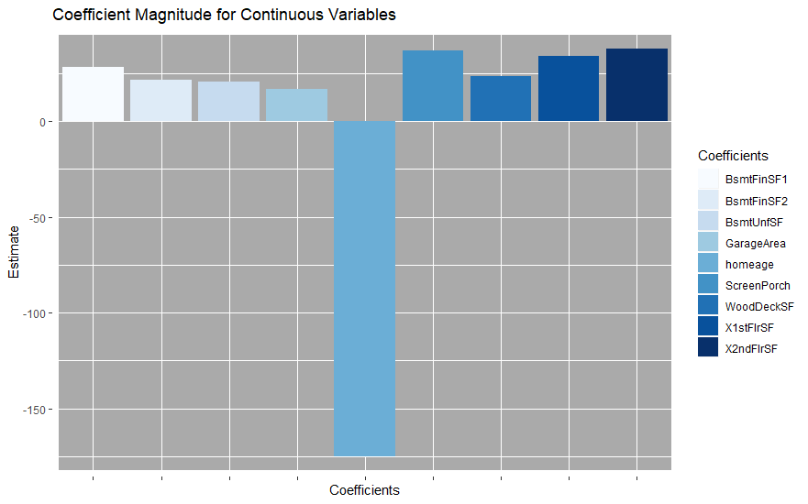
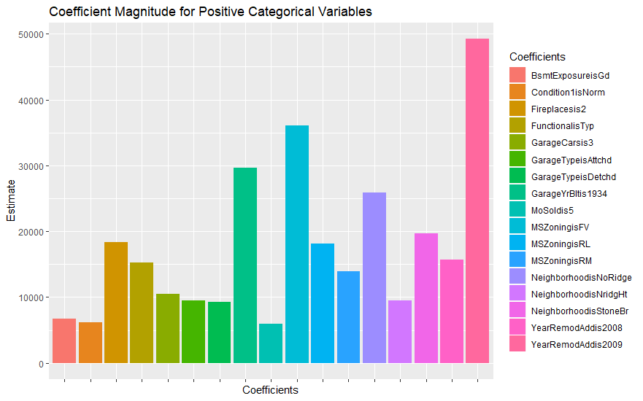
Model Review
Final model based on Remodeled homes consisted of 35 variables
9 continuous variables
26 dummy variables constructed from 15 categorical variables
Initial model attempts used data that was split between continuous and categorical.
Variables with a p-value > .1 were removed
We then combined the two groups and tuned the model accordingly
Finally, we split the data into never Remodeled and has been remodeled.
We created the final model with the homes that have been remodeled and used that to predict the prices of the homes that have never been remodeled.
Our final model had an RSE of $17870. With an Adjusted R-Squared of .8609

Slide 10
Brand Equity Analysis
Consistent with model
Significantly Positive Equities = Significant Model Variables
Northridge
Northridge Heights
Stone Brook
Timberland

Slide 11
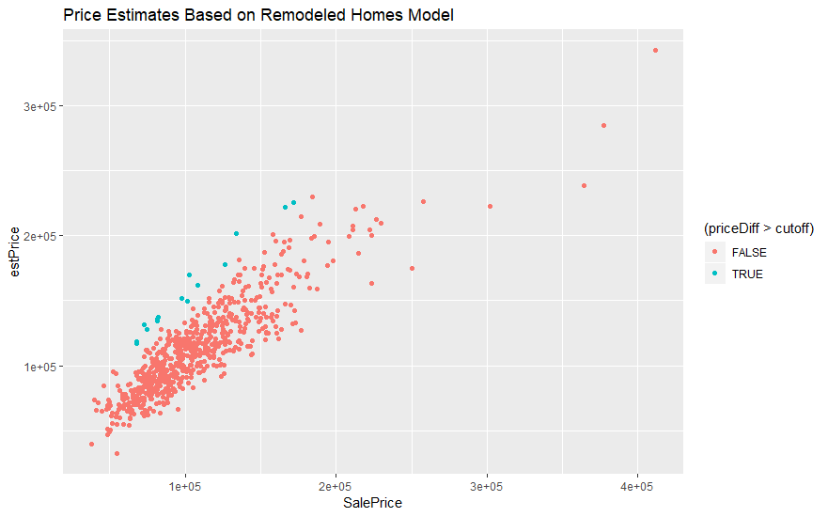
Predictions vs Results
Cutoff based on inflation adjusted average remodel price.(Adjusted to 2000) and Residual Standard Error from the model
Inflation estimator from: https://westegg.com/inflation/infl.cgi
Average Remodel Pricing from: HomeAdvisor.com
Data with estimate higher than Sale on average which is to be expected due to model construction
Some outliers that are well negative

Slide 12
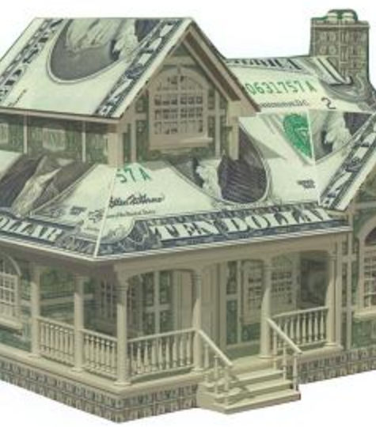
Conclusions and Moving Forward

Slide 13
Conclusions
Based off the model, the following variables are of importance:
Location, both Neighborhood and in relation to adverse features
Garage: Area, Finish and having room for 3 vehicles all add dollars
Fireplaces
Basements: Area, Outer Exposure, Height, and Interior Finish
An example house:
A two-story house was sold in the Northridge neighborhood in 2007 for $302,000. The adjusted price was $166,347.20 and our Estimated price is $222,314.40.
It was built in 1990 and its condition rating is a 5.
It has one fireplace and a two-car attached garage
It has a 500 sq. ft. wooden deck and 971 sq. ft. of unfinished basement space.
A potential remodel would involve the following:
touching up the specifics where the condition is low to bump the overall condition up.
Adding finish to the basement, likely as storage or as additional living space with a second fireplace.
Expanding the garage or adding a detached garage.

Slide 14
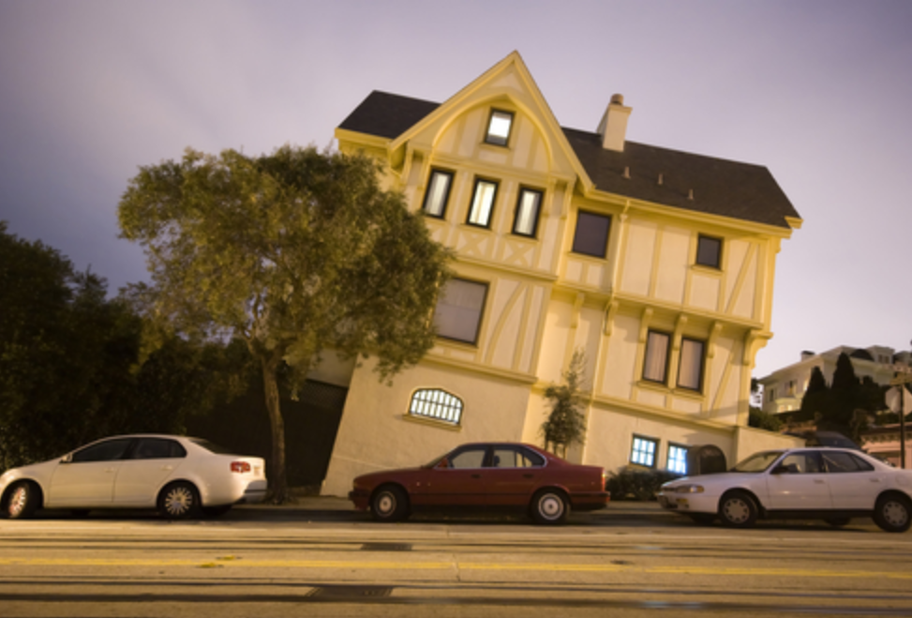
Risk Assumption’s to Business
Undetected property issues
Potential model variation
Changes in market conditions
Lack of current data
Potential pricing index inaccuracies

